Slide 1
Universal Response Engine: LLMs for Good
sdmay25-35

Slide 2
Project Overview
Our project aims to develop a comprehensive, multimodal platform to provide support for people in need in the form of a large language model. These needs could be physical, mental, or just general guidance during hard times.

Slide 3
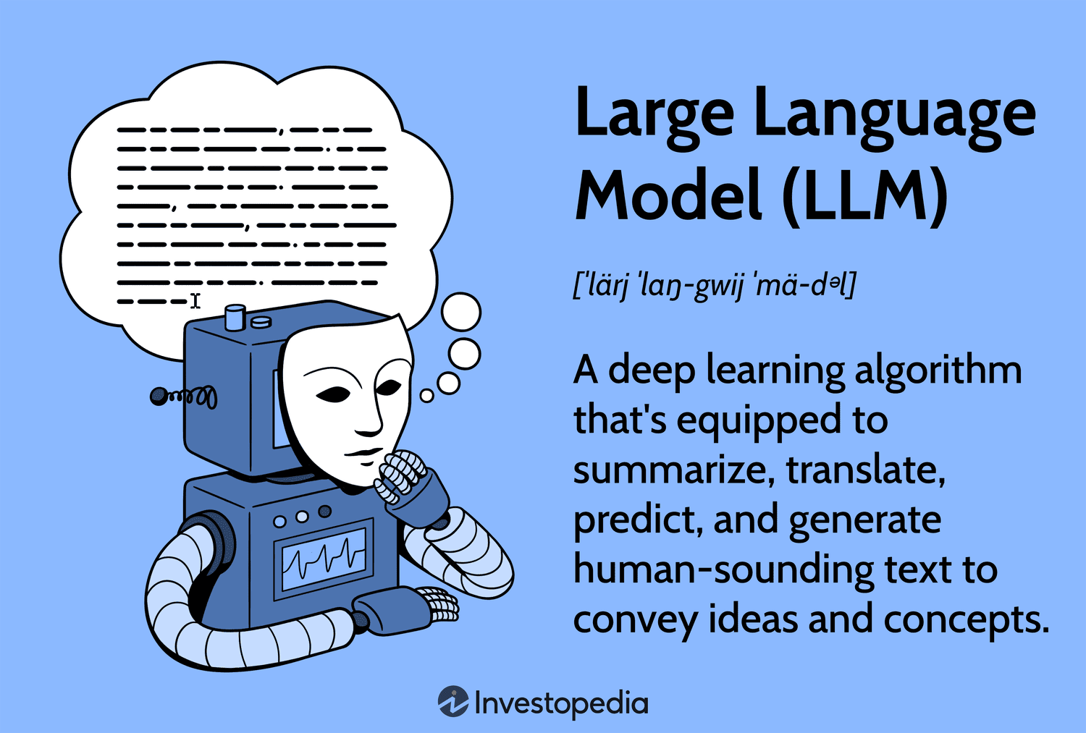

Slide 4
Problem Statement
Vulnerable groups of people, such as homeless or displaced individuals, have difficulty accessing essential services and support, especially during crises. This issue arises everywhere across the world, from cities, to suburbs, or to isolated communities. Creating an interactive information hub that provides timely, accurate, and locally relevant resources can greatly help those in need and in many different situations.

Slide 5
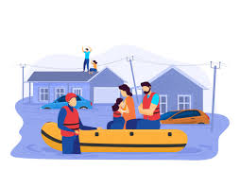


Examples of problems

Slide 6
List of users (and description)
Our project has one type of user: people in need. What differs between users is what they need. We aimed to cover the main emergency services that people could need. For example, someone that has fallen and isn’t sure how to clean their wound. Our chatbot would be able to give concise, step-by-step instructions to clean and wrap the wound.

Slide 7
User Needs
Mental health questions
Medical assistance
Legal direction
Housing advice
Evacuation information

Slide 8
Conclusions
The users of this product are broadly classified with the overarching commonality of looking for help. Our product has several focus areas that the users would ideally be asking about. The users, if they were in an emergency situation, need a product that is knowledgeable, quick, concise, and easy to understand. This context is the inspiration for our project: to be for good.

